Slide 1
Reference Architecture & Reference Implementation Overview Yannis Oikonomidis - INTRASOFT INTL

Slide 2
DEMETER Reference Architecture – Main Elements
Dashboards
Farmers
Experts
Stakeholders
SOCS
DEH
AIS
Developers
Stakeholder catalogue
Users
CI/CD tools
Collaboration tools
Resources
DEMETER Application
Brokerage Service Environment
Knowledge management
Resource access control
DEMETER Enhanced Entity
DEMETER Enhanced Entity
AIM: the DEMETER Agriculture Information Model, a common semantic data model
Service | App | Thing
Service | App | Thing

Slide 3
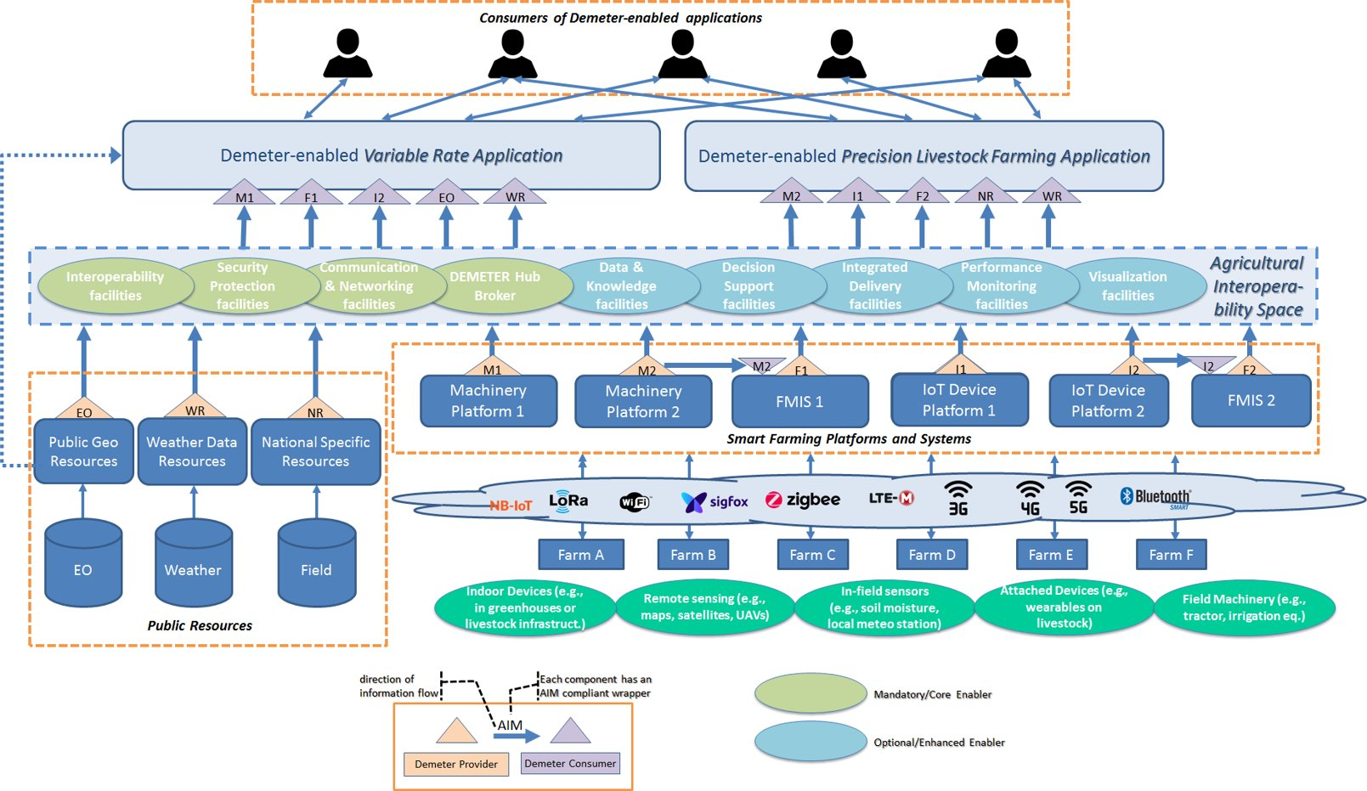
DEMETER Reference Architecture - Instantiation

Slide 4
DEMETER Reference Architecture - Instantiation
Resources
Resources

Slide 5
DEMETER Reference Architecture - Instantiation
Interoperability
Interoperability

Slide 6
DEMETER Reference Architecture - Instantiation
Apps
Apps

Slide 7
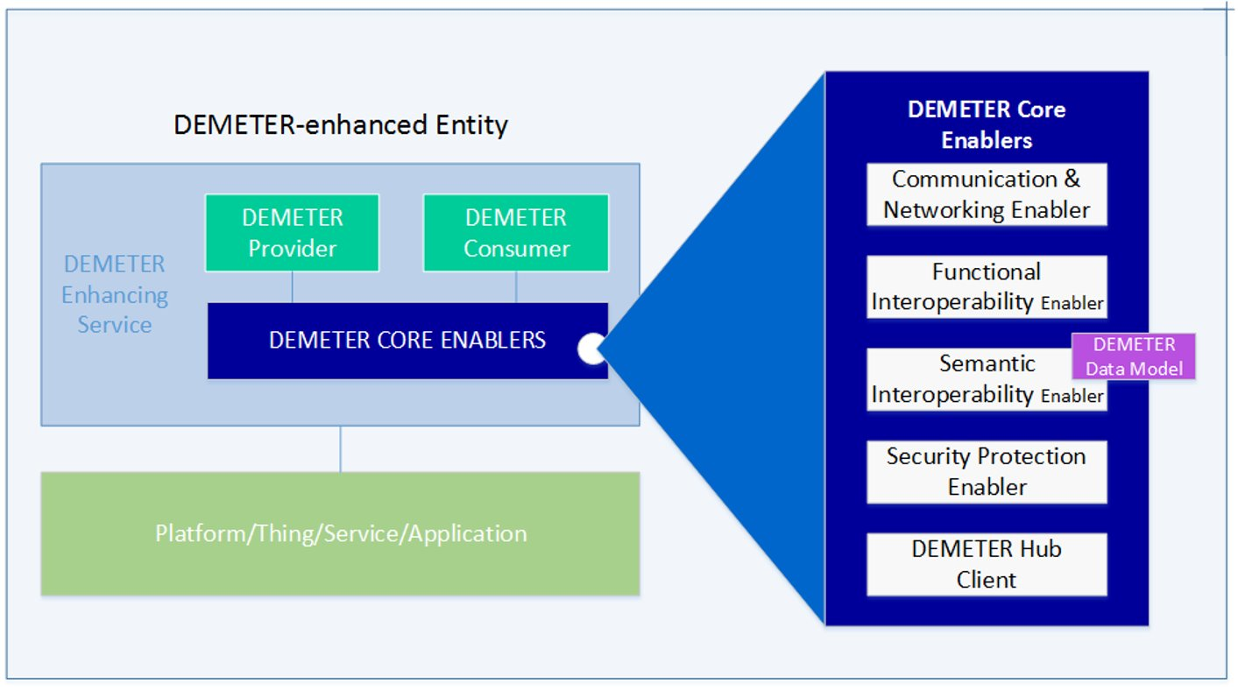
DEMETER Enhanced Entity – Core Enablers
AIM: the DEMETER Agriculture Information Model, a common semantic data model

Slide 8
DEMETER Enhanced Entity – Core Enablers
Functional Interoperability Enabler
DEH Client Enabler
Offers BSE services - acts as the client side of BSE
Registration
Discovery
Provisioning
Uses services from the Semantics Interoperability Enabler
The client side of the DEH component
Provides inter-service communication between DEH 3rd Party services or between DEH and other Enablers to allow discovery or resources creation
Interacts with DEMETER security enabler to guarantee the integrity and security of the exchanged information.
Security Enabler
Communication and Networking Enabler
The client side of the Access Control Server
Provides Authentication/Authorization to other Enablers (both Core and Advanced)
Provides secured channel communication via TLS and SSL protocols
Provides encryption functionality for JSON and XML objects: JSE and XML-Enc

Slide 9
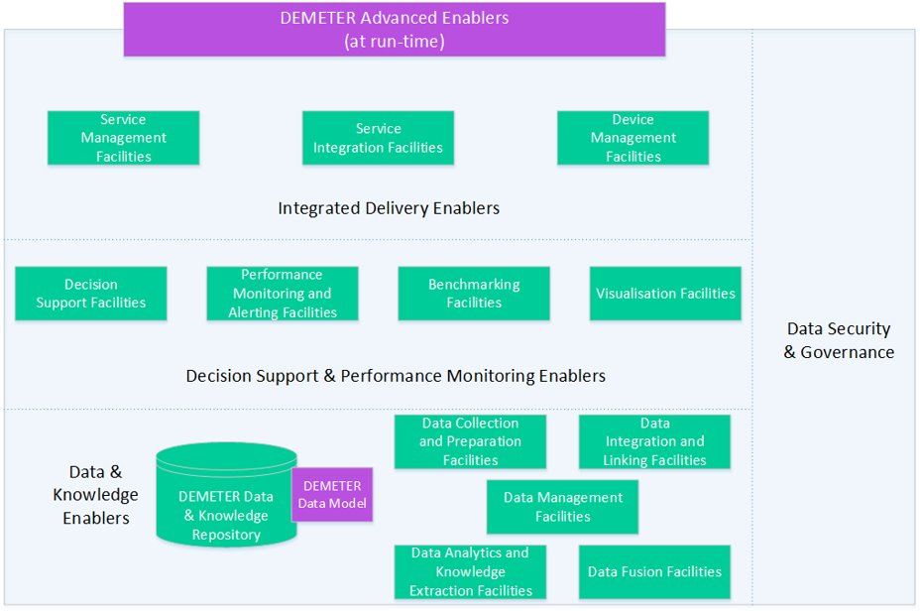
DEMETER Enhanced Entity – Advanced Enablers

Slide 10
DEMETER Agriculture Information Model (AIM)
AIM
Core Meta-Model
Data Catalog Vocabulary (W3C DCAT)
Cross-Domain Ontology
Metadata Schema
SNN/SOSA
OGC GEO
W3C Time
QUDT
Domain-Specific Ontologies
Re-Use
International Data Spaces Information Model
Agri Profile
agriCommon
agriAlert
agriFeature
agriSystem
FOODIE
agriProduct
Saref4Agri
agriCrop
agriResource
agriPest
FIWARE
agriIntervention
farmAnimal
agriProperty
Semantic Interoperability Enabler
FIWARE
SAREF4AAGRI
ADAPT
INSPIRE / FOODIE
AGROVOC

Slide 11
DEMETER Agriculture Information Model (AIM)
Documentation available: https://github.com/rapw3k/DEMETER/tree/master/models

Slide 12
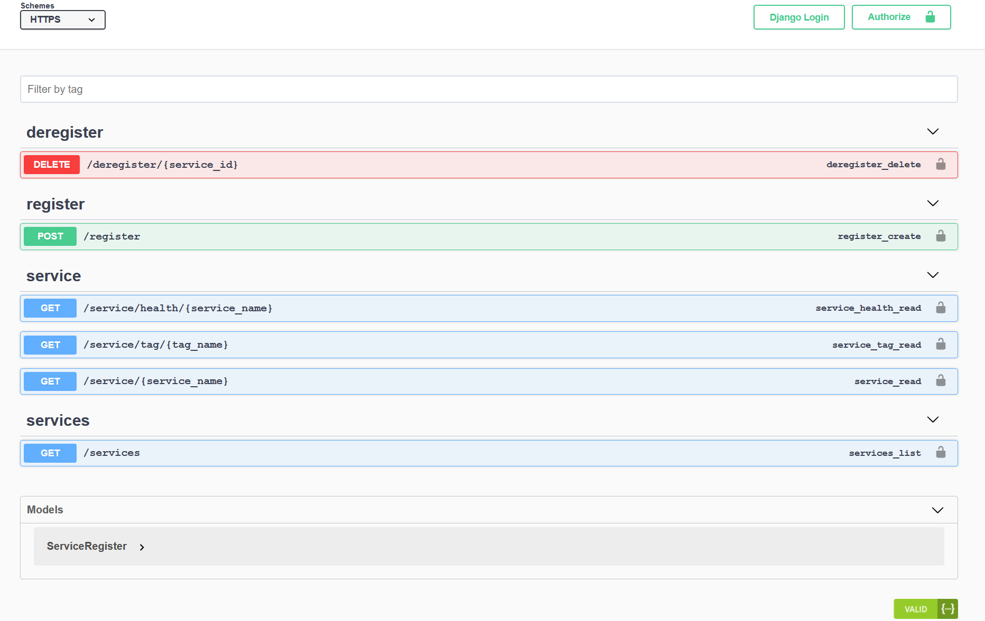
Brokerage Service Environment (BSE) Features
Provides a way through which DEMETER-enhanced Entities (DEEs) can discover one another and provide/consume their services among each other. More specifically:
BSE provides Service Discovery.
Provides a way to register and deregister a service in the BSE services' catalog.
Provides a way for a DEE to retrieve network information of another DEE that is already registered in BSE services' catalog, thus facilitating the communication establishment between them.
Provides a way to monitor the health status of a registered service.
Building upon the health status service and Consul's distributed flavor, BSE's functionality can be extended to provide for load balancing and horizontal scaling.

Slide 13
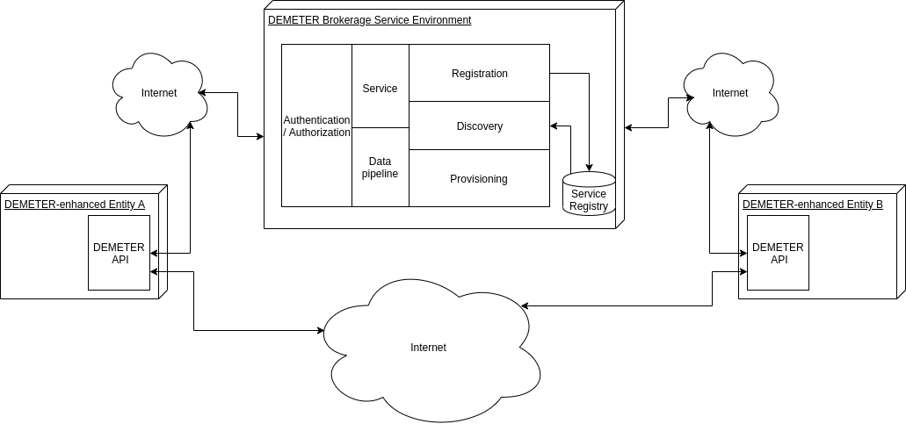
Brokerage Service Environment (BSE) Features
Microservices-based framework
DEEs after auth will be able to consume BSE's API for service registration/discovery/ provisioning
DEEs will have direct communication through REST APIs with other DEEs after successful provisioning
Alternatively, DEEs will have the option to subscribe to a DEE (supporting the pub-sub paradigm)

Slide 14
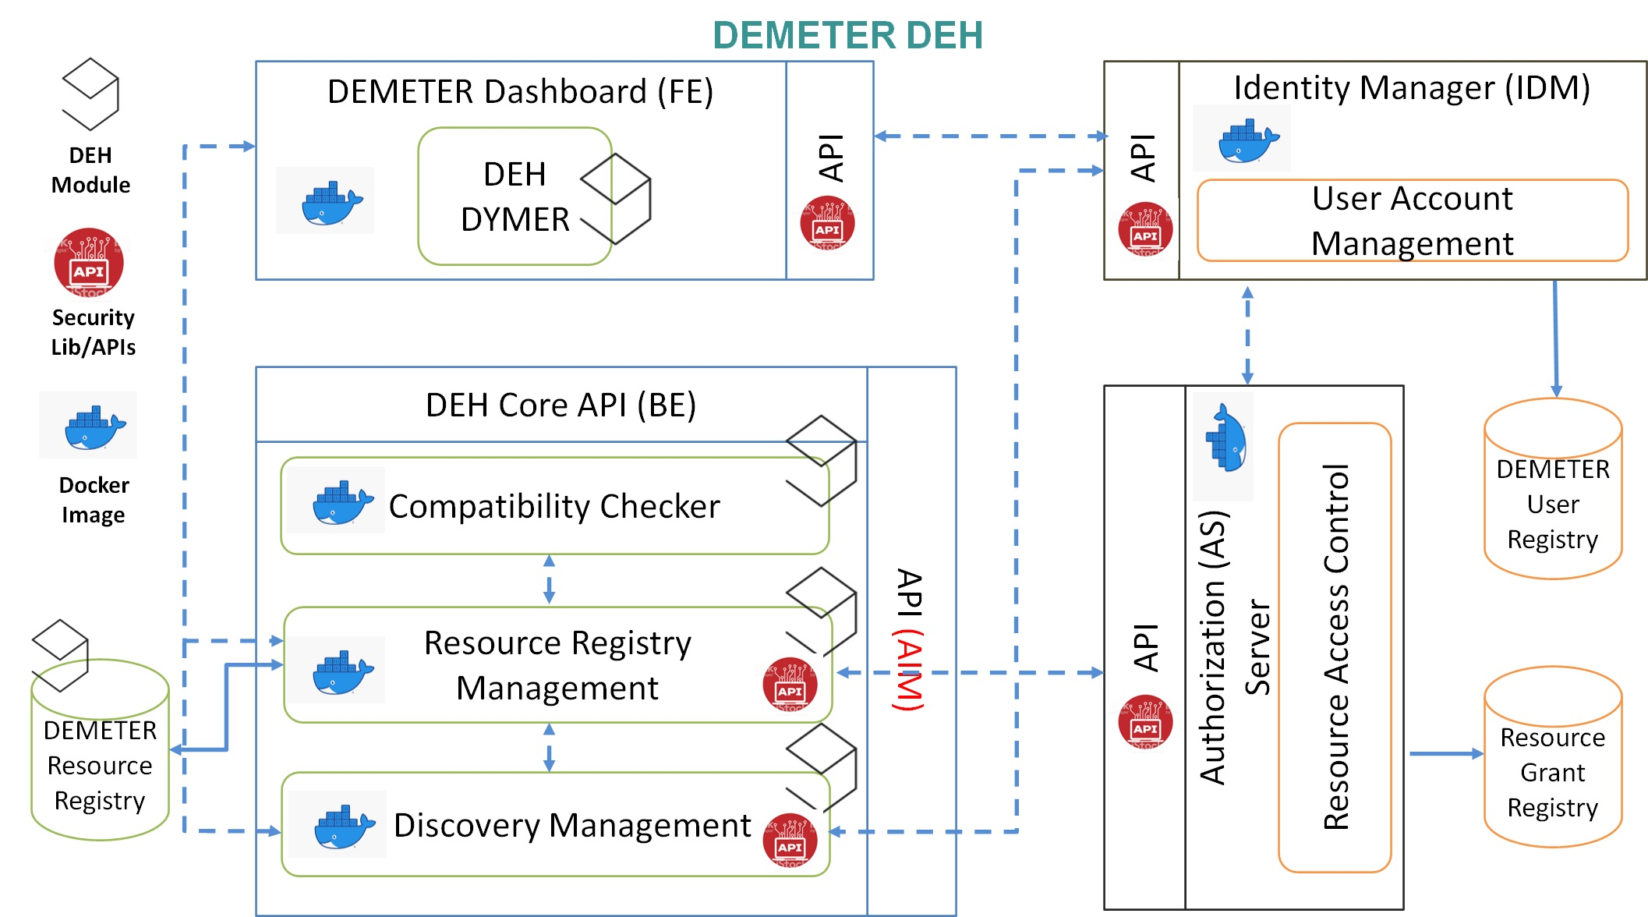
DEMETER Enabler Hub (DEH) Features
Provides a DEH Client Dashboard where user can register, manage, and consume DEH Resources. It also provides Resource Registry Management, a module in charge of storing data about DEH Resources. More specifically:
Allows user to register, search, modify and delete DEH Resources at any time.
Allows user to control Access Policies related to their components
Provides a Discovery Module, which supports advanced search based on all criteria that a DEH Resource has.
Allow user to see statistics of the registered modules (history of consumption, rating, history of versions)
Provides through a Compatibility checker the validation that the new DEH Resource is compatible with the rest of DEMETER.
Provides the Audit module that is in charge of gathering information about editing, version, consumption and rating of a DEH Resource.

Slide 15
DEMETER Access Control Server (ACS) Features
Authentication
DEMETER Applications and Users registration process
Authorization
Fine-grained access control mechanism
Traceability
The Traceability Agent will keep record of the users’ activities to access DEMETER resources by logging the issue and use of authentication and authorization tokens.
REST API for logging and retrieving the details of the use of the authentication and authorization tokens.

Slide 16
DEMETER Reference Implementation approach
DEMETER central cloud
Pilot infrastructure
Brokerage Service Environment
Brokerage Service Environment
SOCS
DEMETER Enabler Hub
DEE
DEE
DEE
DEE
DEE
DEE
DEE
DEE
Pilot infrastructure
DEE
Reference implementation
DEE
DEE
Pilot implementation
A BSE may support multiple pilots
Multiple BSE instances allowed to connect to DEH
A DEE from another BSE may be used (if allowed by access control)

Slide 17
For more information visit:
www.h2020-demeter.eu
or Email us at :
info@h2020-demeter.eu

